Slide 1
CSS Area
SANA Registry
FRM Editor
FRM File (XML)
FRM Type File (ASN.1)
Review

Slide 2
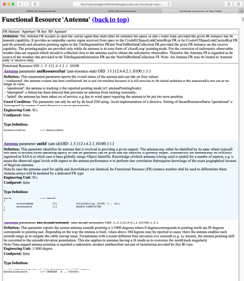
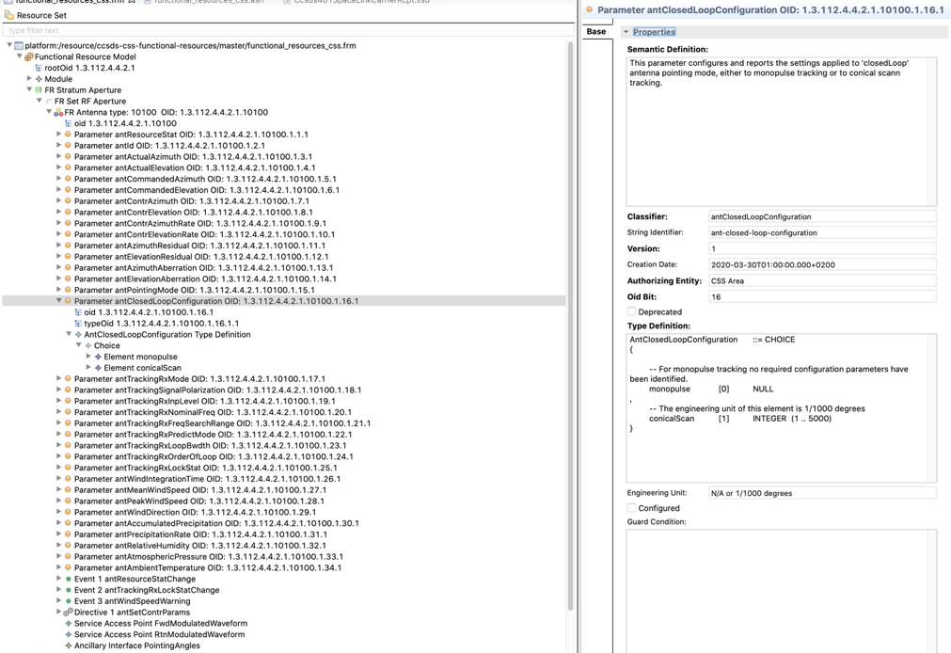
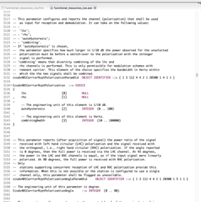
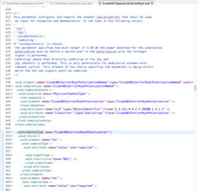
XML for SANA
and
Documentation
(review)
Transfer Syntax (ASN.1)
Configuration Profile
(XSD)
2

